Slide 1
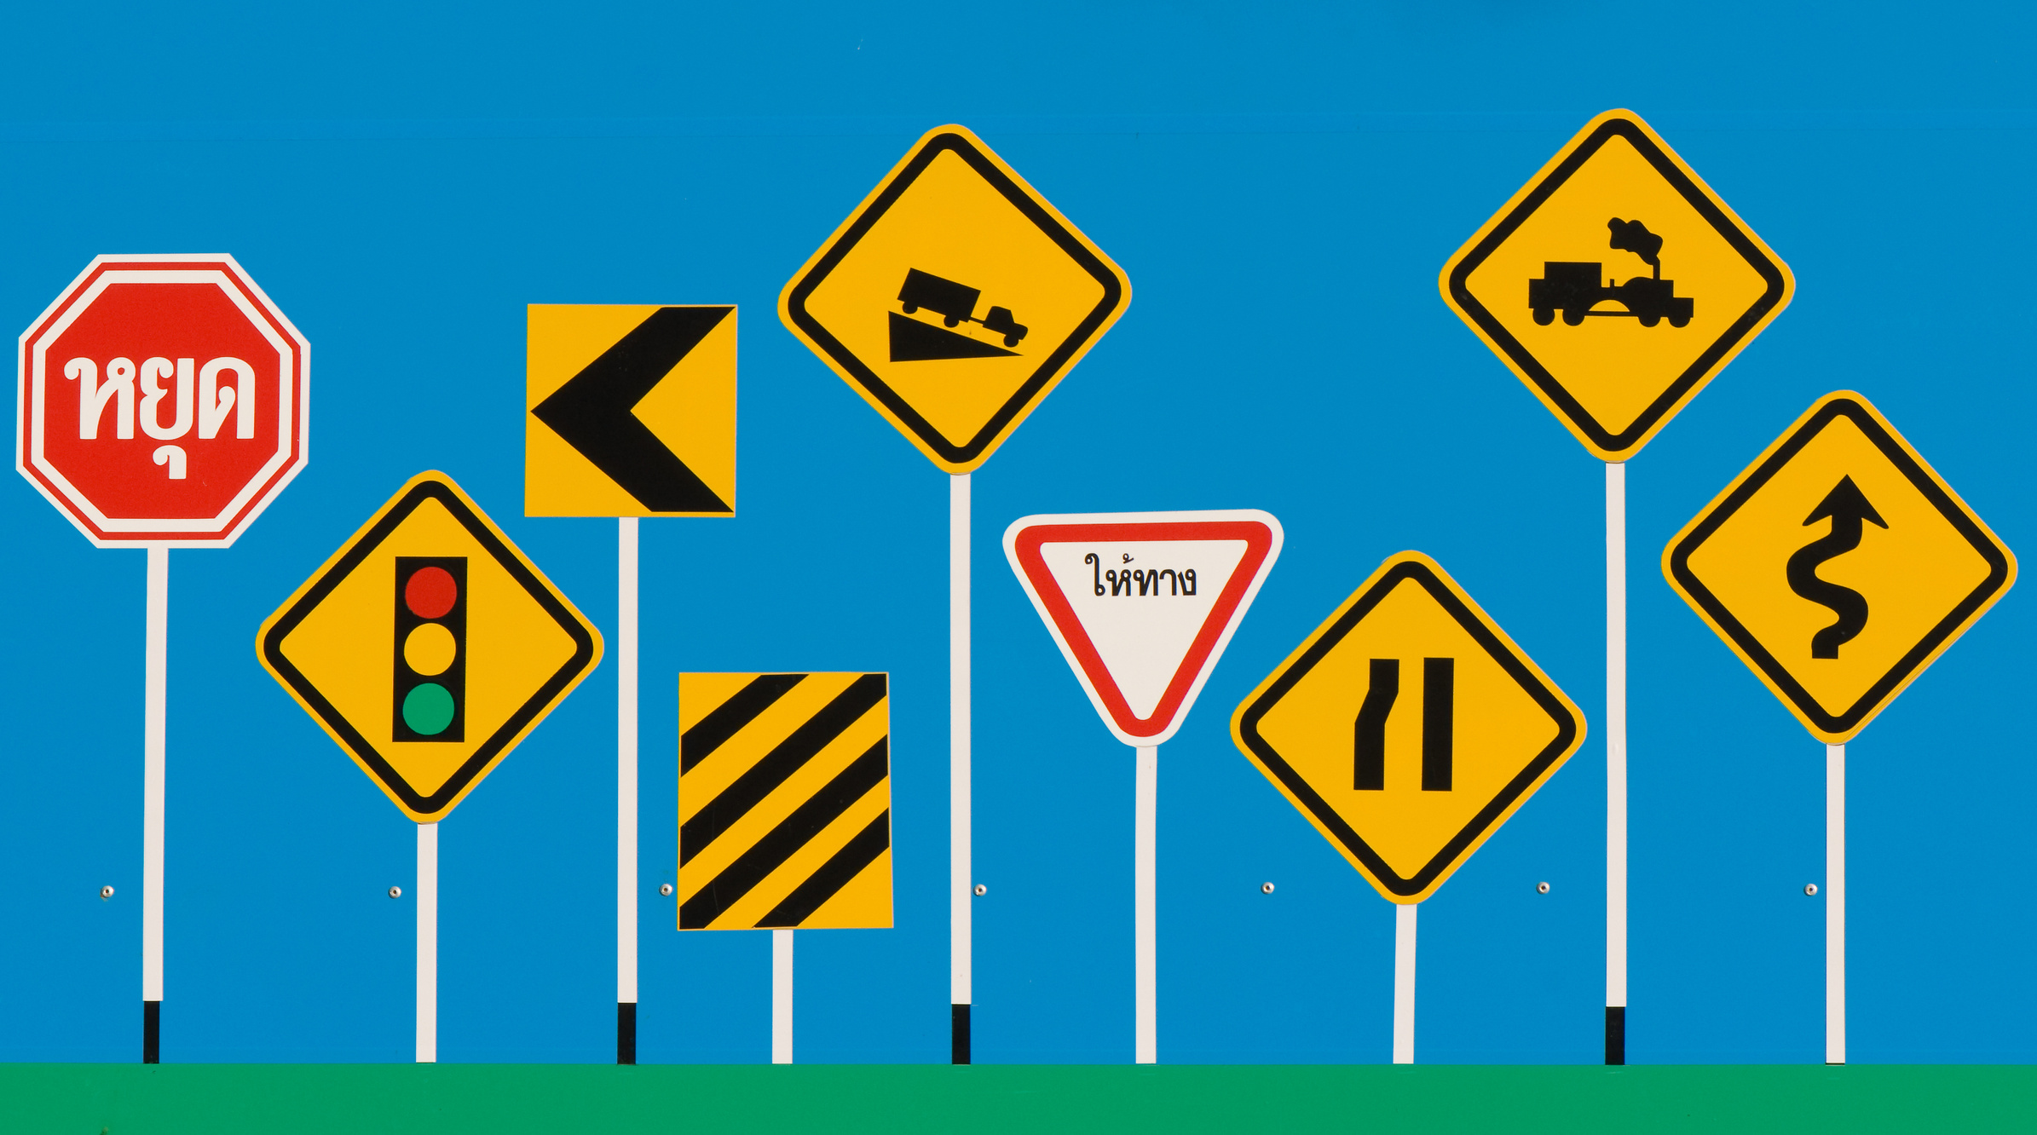





TRAFFIC SIGN RECOGNITION
Team 33
Lim Zeen Kiat,
Kevin Tan Shin Wei,
Robin Ghosh,
Delphino Chew Jing Cheng
1

Slide 2

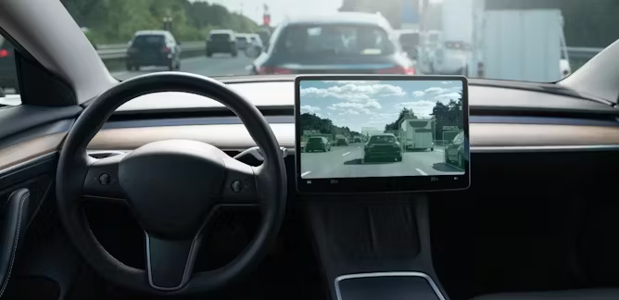
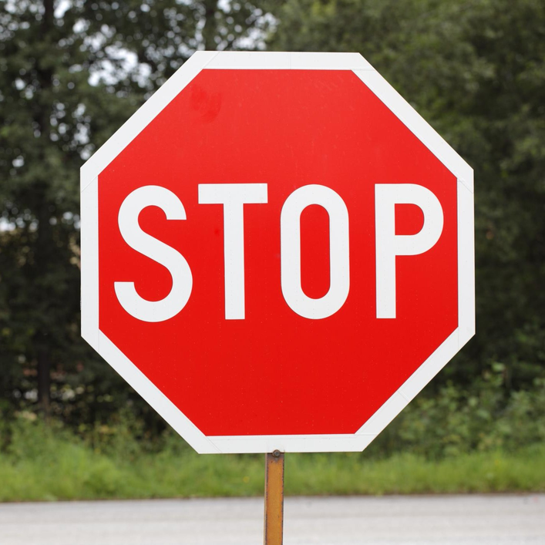
Autonomous Cars
Able to drive without human assistance
Already capable of basic functions like steering
However, there are still complex aspects that must be resolved
2

Slide 3
Related Works
Deep learning
1) Convolutional Neural Network
(CNN)
Accuracy of 99.9%
Major drawback of overfitting
May struggle in real world applications where features may be affected by external factors like blurriness or the images’ angles
Machine learning
1) Support Vector Machine (SVM)
Accuracy of 90.2%
2) Random Forest (RF)
Accuracy of 85.6%
Typically outperformed by deep learning models given large datasets
3

Slide 4
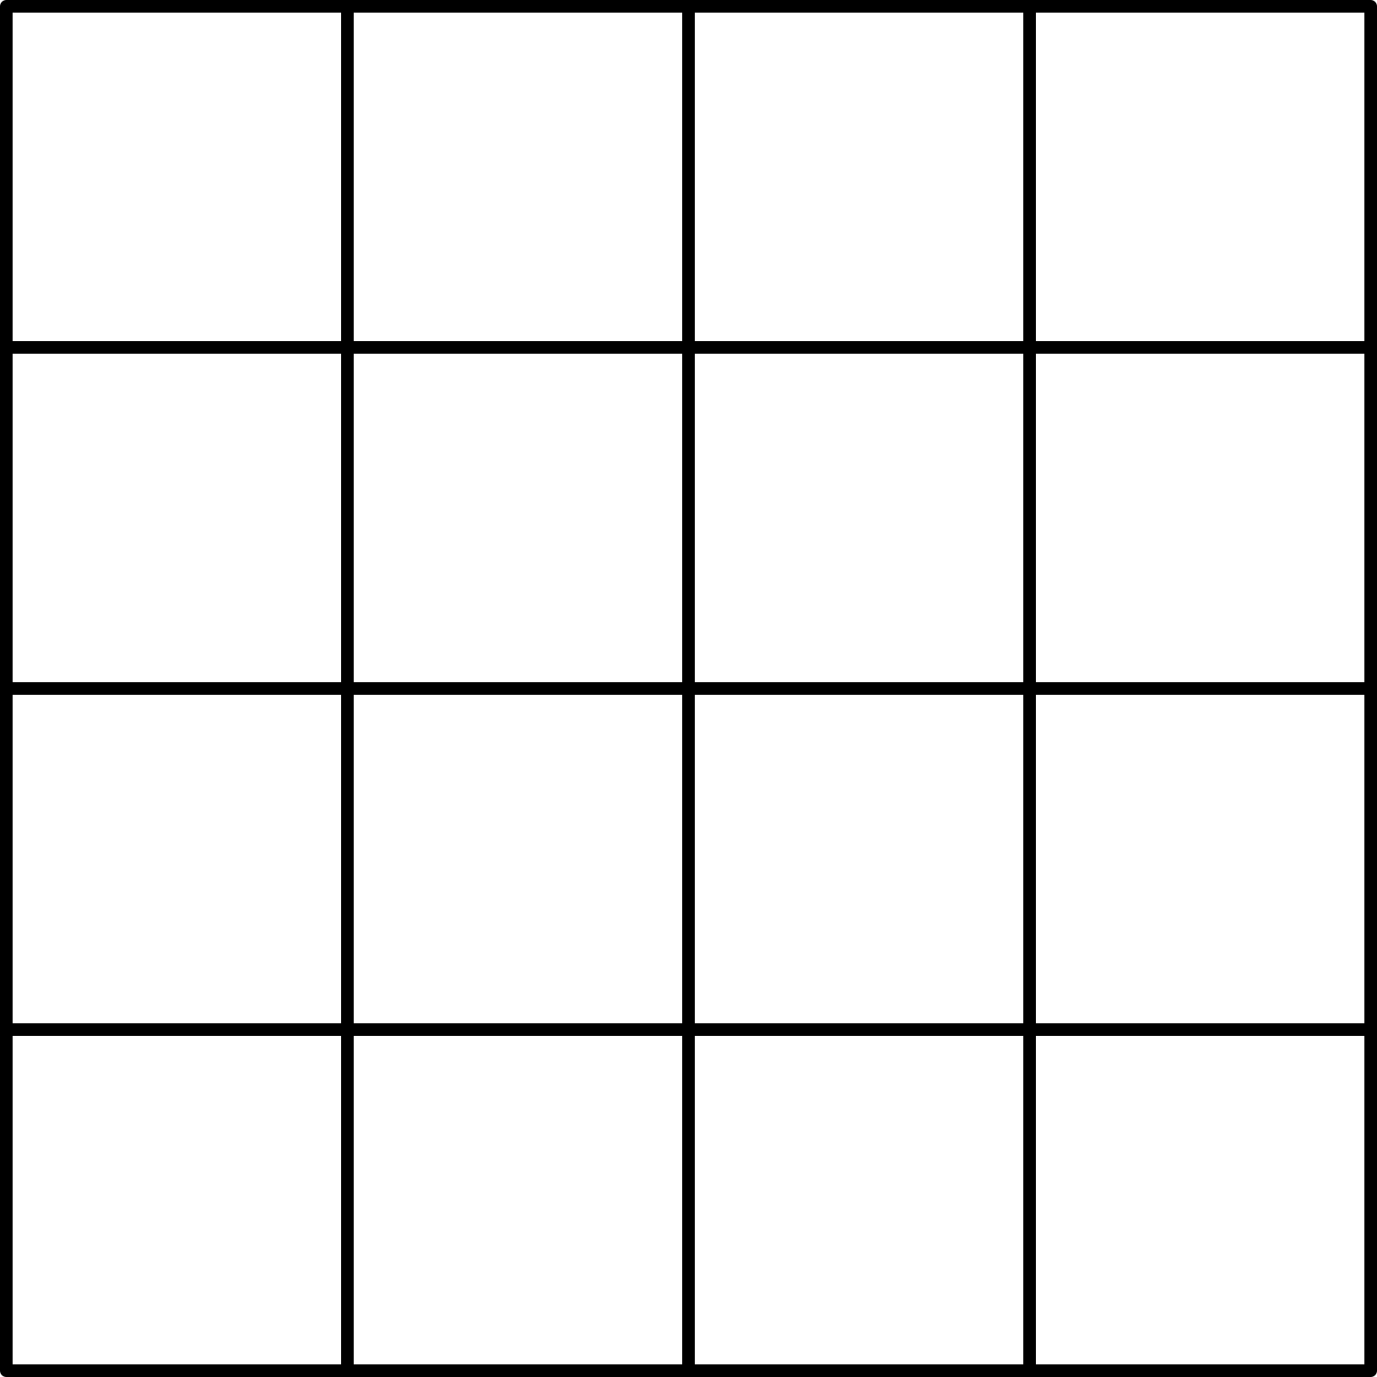

Dataset
4896 images of road signs
23 different signs, each ranging from 100 to over 500 images
Red-Green-Blue (RGB) images
Each pixel has 3 values from 0 to 255
67
26
12
Varying sizes, from 62x65
to 272x263
4

Slide 5
Preprocessing
Dataset
Normalization
Resizing
Flattening
(for SVM and RF)
divide values by 255
transform to 94x94
flatten 3D into 1D array
5

Slide 6
Approach
Dataset
Stage 1
Stage 2
5 Groups
(20% each)
Testing
(20%)
Training
(80%)
5-Fold Cross
Validation using
Add Gaussian noise and blur
Evaluate using
CNN
SVM
RF
Determine
using accuracy
Final Model
Augmented
Train
6

Slide 7

Convolutional Neural Network (CNN)
Supervised deep learning model
Commonly used for image pattern recognition tasks
Convolutional layers
Fully connected layers
Input layer
Pooling layers
Output layer
7

Slide 8
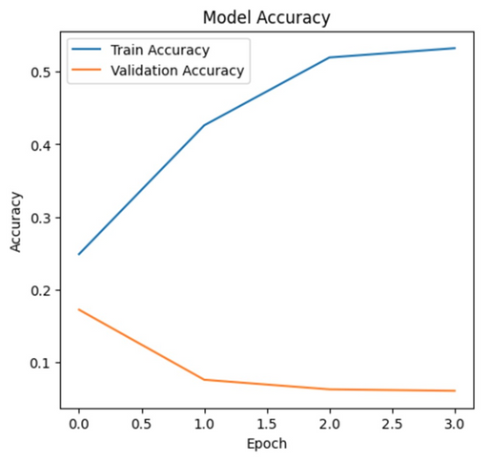
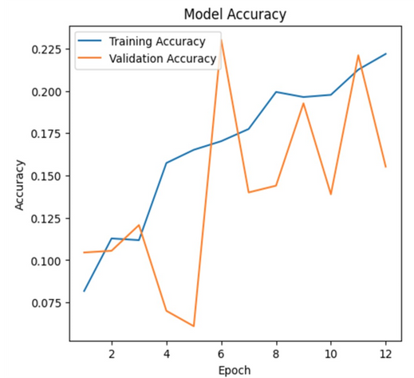
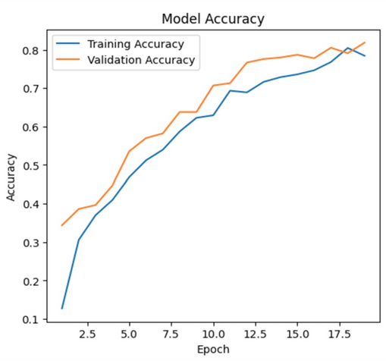

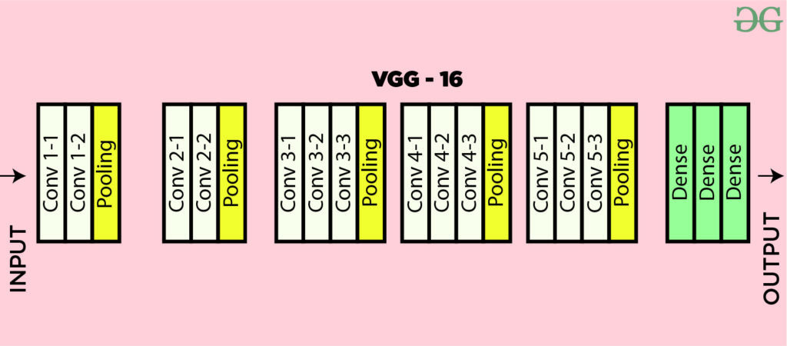
Building Our CNN Model
MobileNetV3
ResNet50
VGG16
13 convolutional layers
3 fully connected layers
Max Pooling layers
8
Image Source: GeeksforGeeks. "VGG-16 CNN Model." Retrieved from https://www.geeksforgeeks.org/vgg-16-cnn-model/

Slide 9


Our CNN Model
Conv2D
Conv2D: Applies filters to input images, creating feature maps which capture local patterns such as edges, shapes and textures
MaxPooling: Reduces height and width of the feature maps while retaining the most important features
Dense: Apply weights to incoming features and process them through activation functions (ReLu)
Dropout: Randomly disables some neurons during training
For compiling the model:
Optimizer --> Adam
Learning rate --> 0.0001
Loss function --> Sparse categorical cross-entropy
MaxPooling
Conv2D
MaxPooling
Flatten
Input layer
Output layer
Dense
Dropout
Dense
Dropout
Dense
9

Slide 10




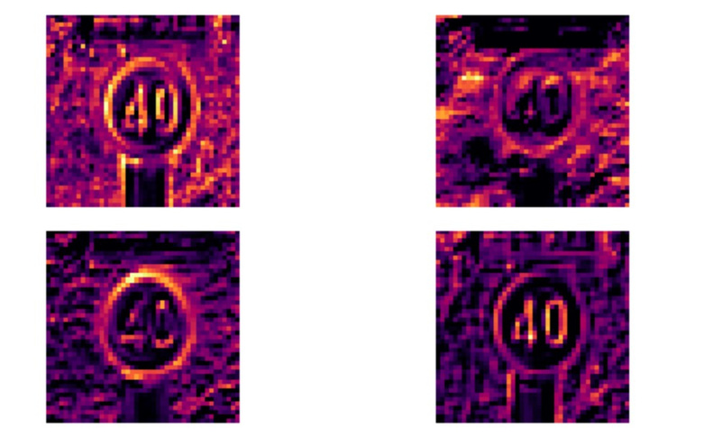
Advantages
Limitations
Translation-invariant
Computationally expensive
Complexity in designing effective CNN model architecture
Can learn spatial hierarchies of patterns
10

Slide 11
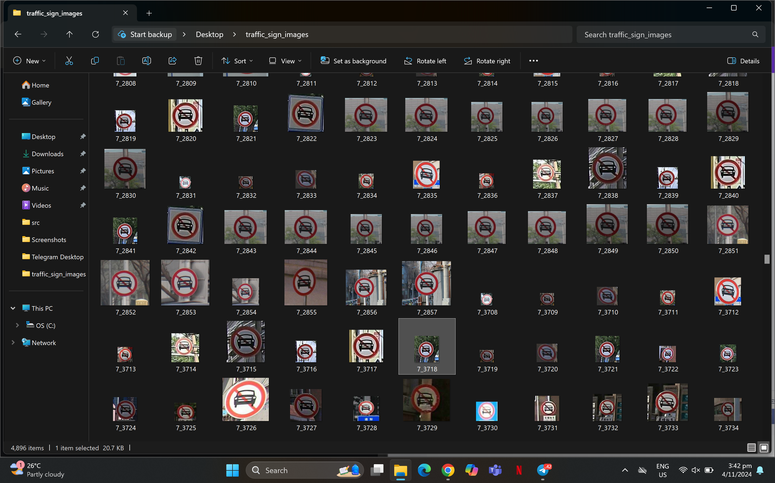
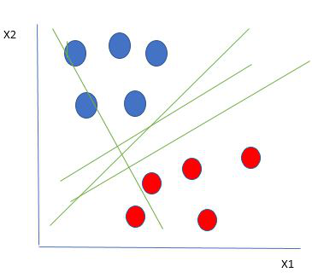

Support Vector Machine
Linear and non-linear classification
Works in an N-dimensional space based on number of features
01
Supervised
02
Hyperplane
03
Optimization
Trained on a set of labelled data
Separate data points into different classes in the feature space
Makes use of kernel tricks, hyperparameter tuning and minimising a function
11

Slide 12
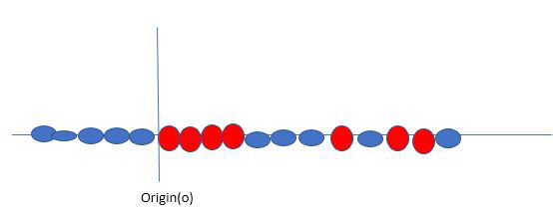

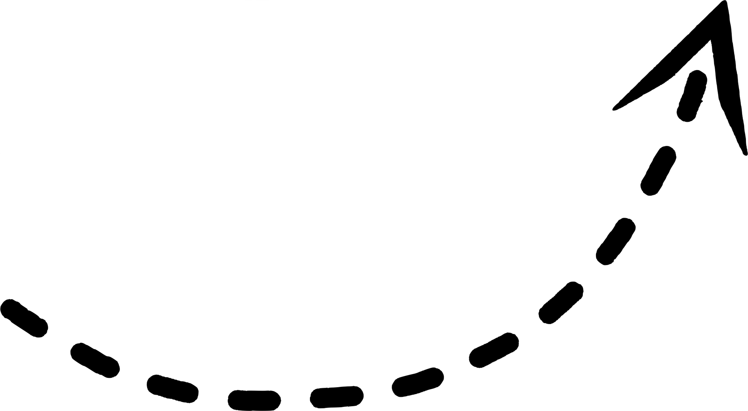
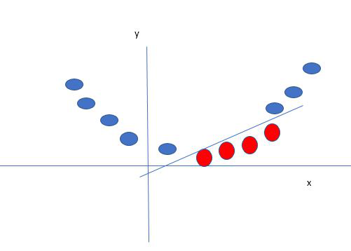

Support Vector Machine
Consider a group of red and blue balls that are not linearly separable.
Excels in high-dimensional performance
Non-linear capability
Requires careful tuning of kernels and parameters like C
Sensitive to noise
Slow training
Limited interpretability
Feature scaling sensitivity
Kernels create a new variable, yi, w.r.t. the point, xi.
12

Slide 13
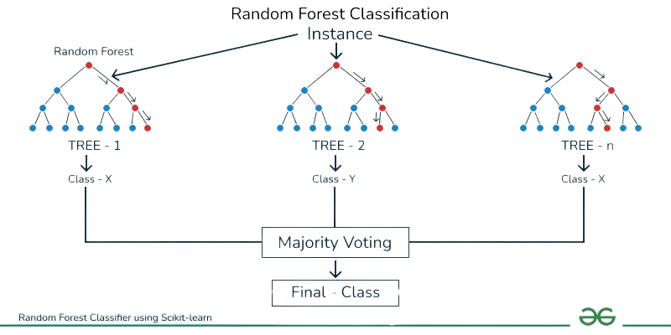
Random Forest Classification
Involves an ensemble of decision trees
Creates a set of decision trees from a randomly selected subset of the training set
01
Supervised
02
Decision Trees
03
Bagging
Trained on a set of labelled data
Collects the votes from all the decision trees to decide the final classification
Recursively partitioning the data based on features, then selecting best features at each split
13

Slide 14
Random Forest Classification
Effective on datasets with large number of features
Less prone to overfitting
Computationally expensive
Challenging for interpretation
Biased towards majority class in imbalanced datasets
n_estimators = 3 --> 3 Trees
max_depth = 3 --> 3 Levels
14

Slide 15
5-Fold Results
Iteration | CNN | SVM | RF
1 | 98.40 | 94.22 | 94.83
2 | 99.30 | 95.02 | 93.39
3 | 99.97 | 96.43 | 94.70
4 | 99.97 | 93.95 | 92.72
5 | 99.21 | 95.88 | 94.12
Average | 99.32 | 95.10 | 93.95
15

Slide 16
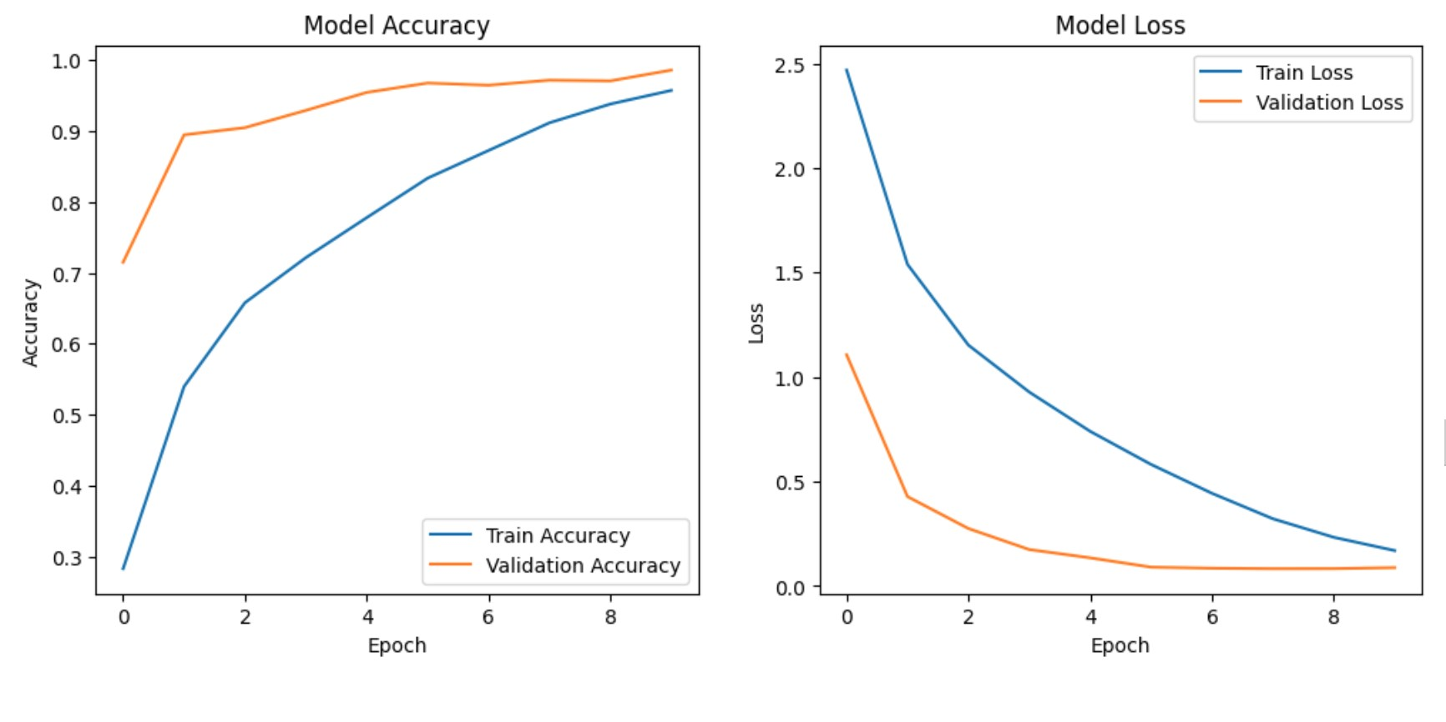
Model Performance - CNN
97.00%
16

Slide 17
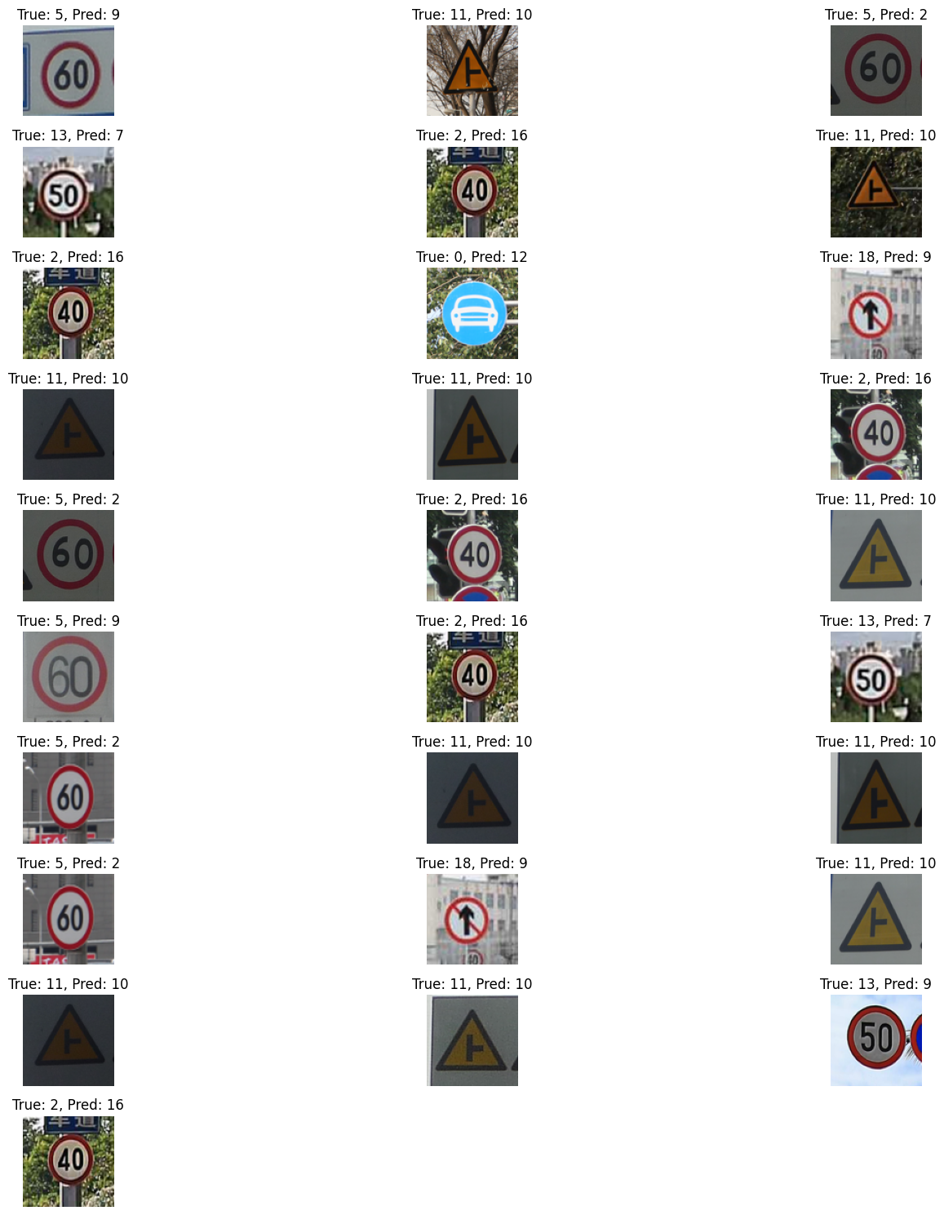
17

Slide 18
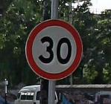
True Class 16
18

Slide 19
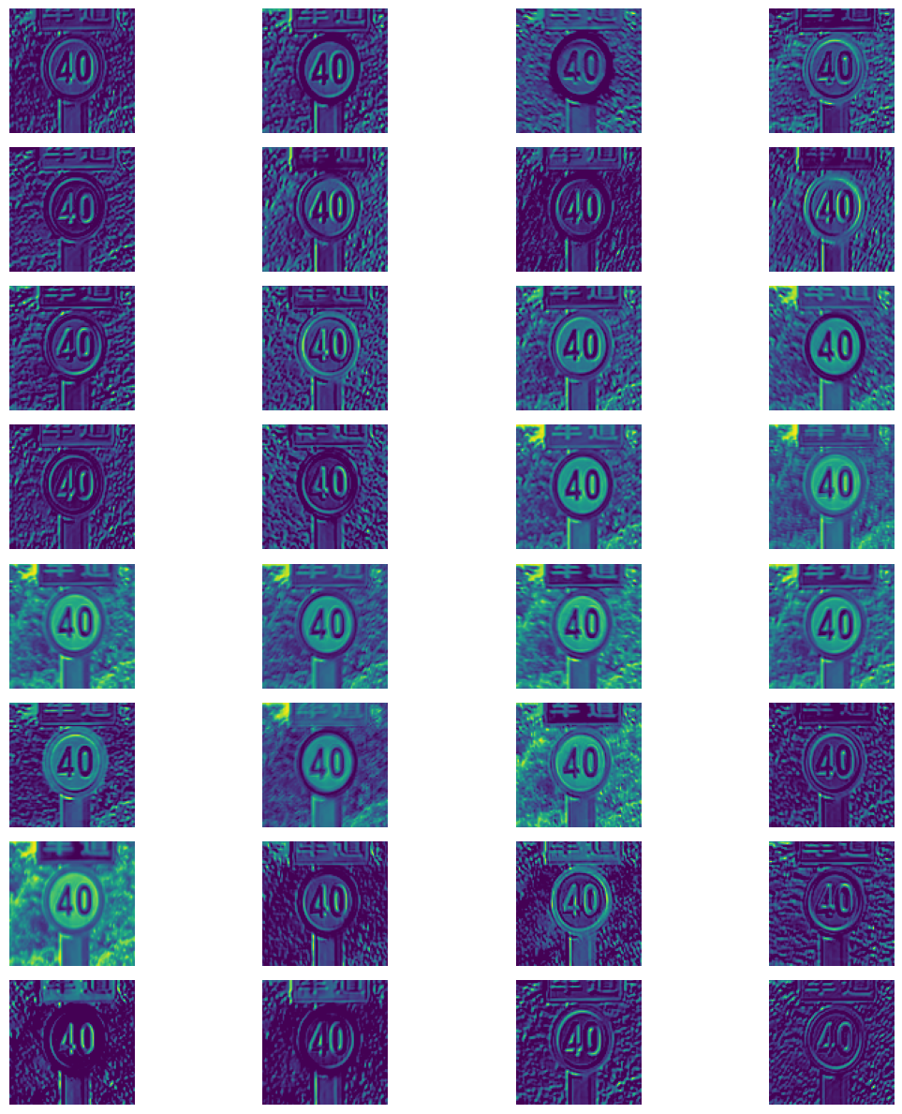
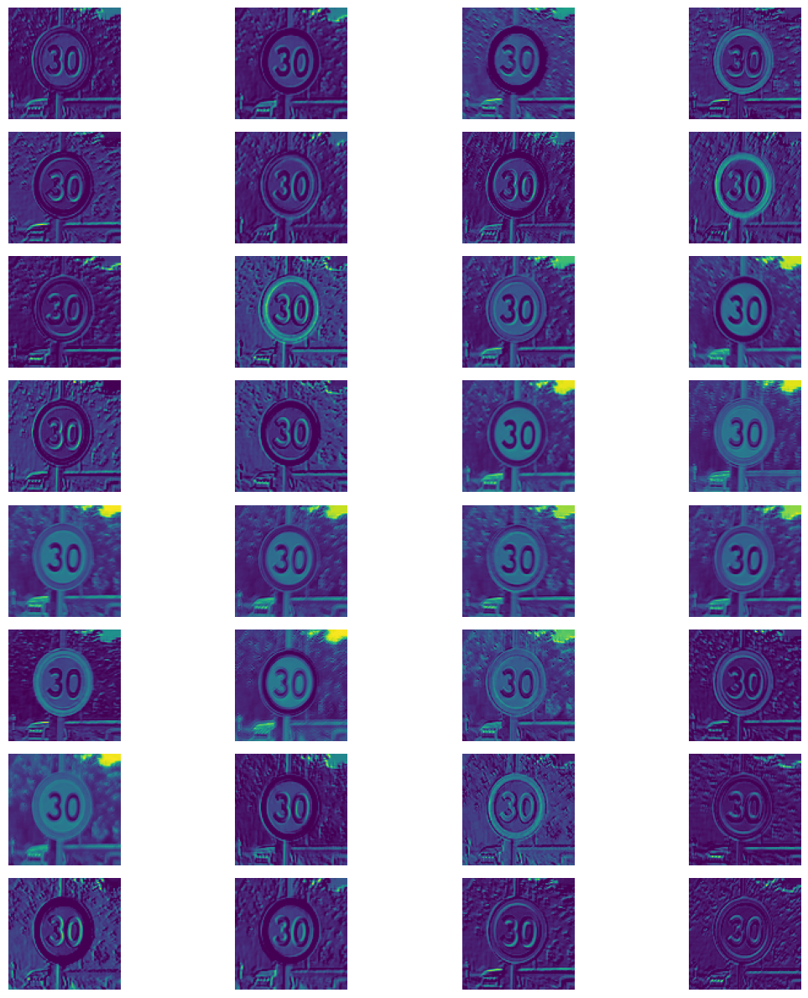

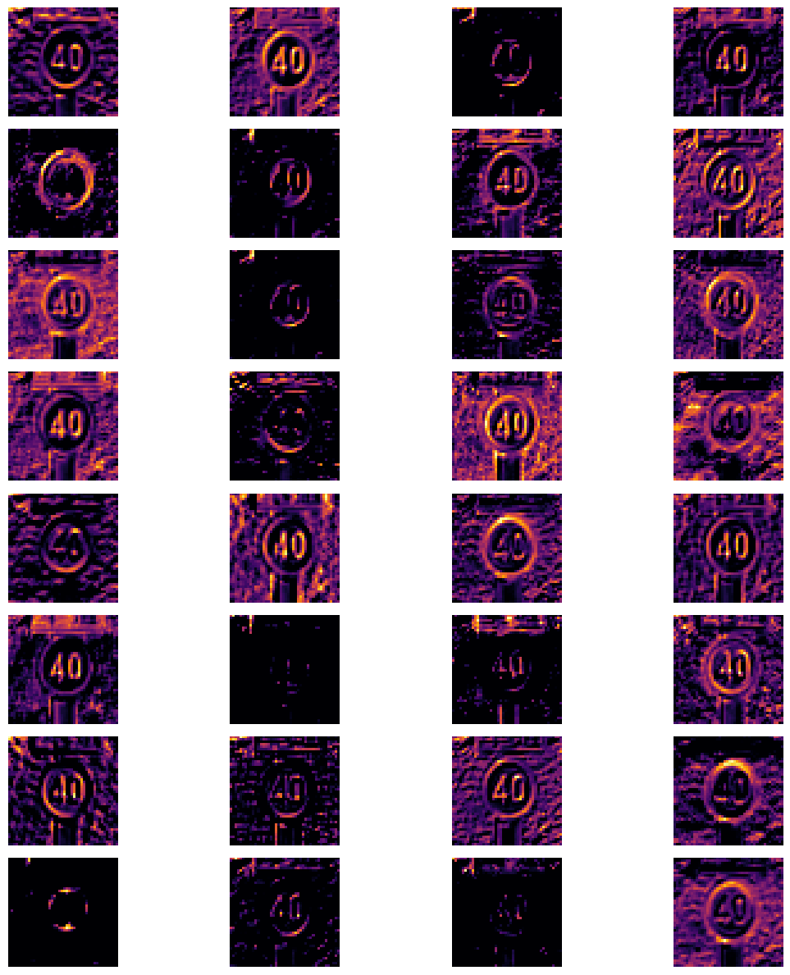
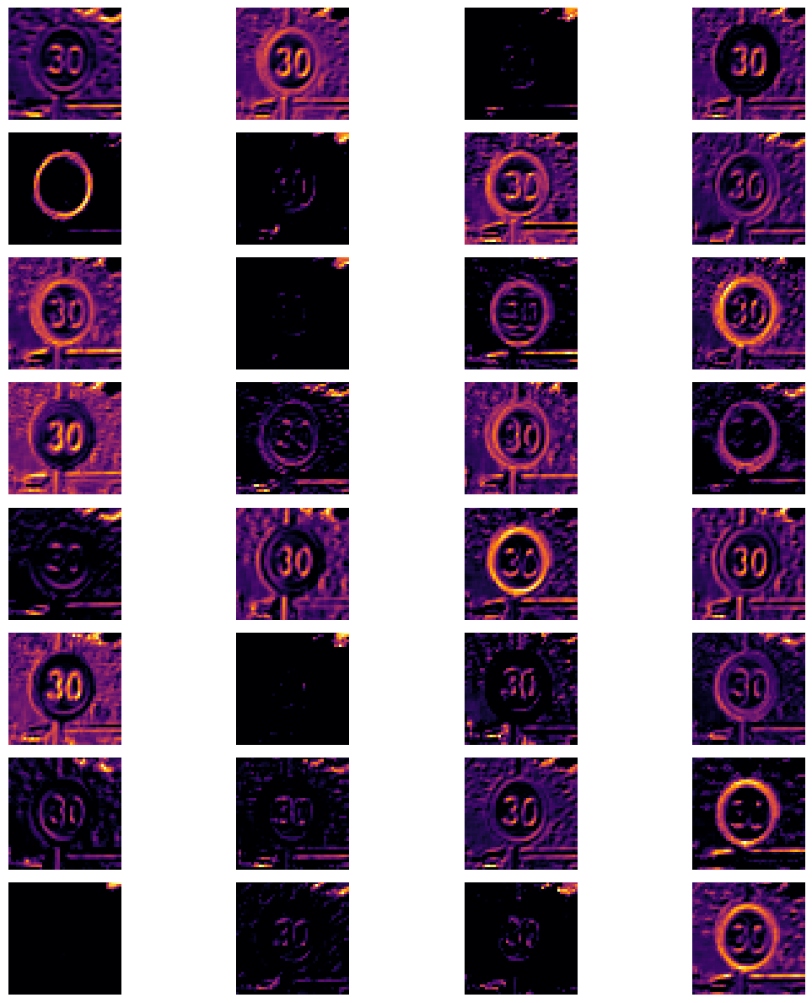
Class
Class
2
16
19

Slide 20

CONTRIBUTION
Member | Contribution
Lim Zeen Kiat | 25%
Kevin Tan Shin Wei | 25%
Robin Ghosh | 25%
Delphino Chew Jing Cheng | 25%
20

